Slide 1
Year 2 Wellbeing
Bonds to 10 and the next multiple of 10 | Place value Adding two numbers | Counting in steps of 2, 3, 5 and 10
Expressive Arts covered movement, art (painting), art (paper sculpture), music, art (patterns & colouring)
Objectives
Day 1 Move to the Numbers
Recall and use addition and subtraction facts to 10 and 20.
Day 2 Hidden Numbers Painting
Recognise the place value of each digit in a 2-digit number (tens, ones). Add two 2-digit numbers using pictorial representations, and mentally.
Day 3 Spiral Number Snakes
Count in steps of 2, 3, and 5 from 0, and in tens from any number, forward and backward.
Day 4 Percussion Numbers
Add and subtract numbers using concrete objects, pictorial representations, and mentally, including: a two-digit number and ones; two two-digit numbers.
Day 5 Hop to 100
Add numbers mentally, including: a two-digit number and ones, two two-digit numbers.
Notes:
Before teaching, be aware that:
On Day 1 you will need Movement number cards (resources), Pairs to 10 colouring (resources).
On Day 2 you will need Paints, paintbrushes, paper, Kandinsky circles colouring sheet (resources).
On Day 3 you will need Pre-made spiral number snake with a counting in 2s pattern (you will need to make this prior to the lesson), sheets of A4 paper, watercolour paints, paintbrushes, colouring pens, Plenty of copies Spiral number snake templates (resources), Mindfulness snake colouring sheets (resources).
On Day 4 you will need Percussion instruments, e.g. triangles and tambourines.
On Day 5 you will need Dice, chalk, whiteboards and pens; Rainbow addition (resources).

Slide 2
Day 1: Recall and use addition and subtraction facts to 10 and 20.
Expressive art Movement
1
Look at these numbers. Talk to your partner.
Which pairs add to make 10?
8
5
2
3
4
7
6
10
9
0
5
Notes:
Agree which pairs of numbers add to ten, asking children to show these on their fingers as you go through them, e.g. 4 fingers standing up and 6 folded down.
Rehearse all the bonds to 10.

Slide 3
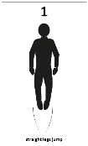
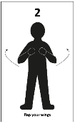
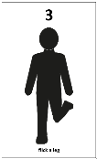
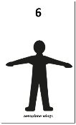
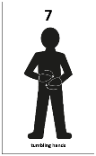
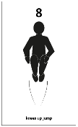
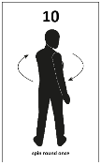
Day 1: Recall and use addition and subtraction facts to 10 and 20.
Expressive art Movement
Look at these movement number cards.
Who would like to come and have a go?
Each number represents a movement.
Notes:
Ask three children to come out front and stand in their own space, where the class can see them. When you say a number, they must perform the matching movement, e.g. you say ‘three’ and they ‘flick a leg’!

Slide 4
Day 1: Recall and use addition and subtraction facts to 10 and 20.
Expressive art Movement
Now perform the movement for the number that we add to it to make 10.
Notes:
Now say a number, e.g. ‘three’ and children must perform the movement for the number that goes with it to make 10, e.g. show ‘tumbling hands’ (7).
Extend by saying a number such as thirteen. Children have to do the movement for the number that matches 13 to make 20.

Slide 5
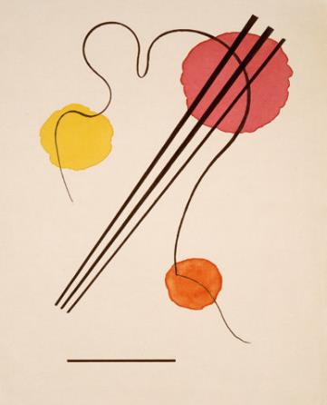
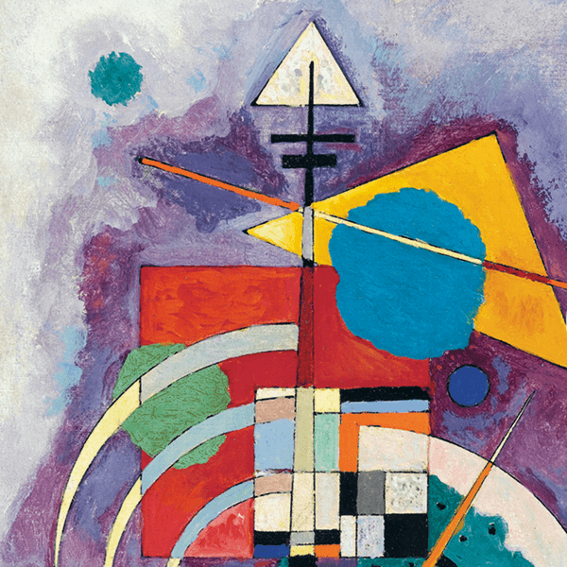
Day 2: Recognise the place value of each digit in a 2-digit number (tens, ones). Add two 2-digit numbers mentally and using pictorial representations.
Expressive art Painting
How many 10s and 1s can you see in each painting?
Notes:
Explain that we can hide messages in paintings – like secret codes. Agree that the large circles represent tens and the small circles represent the ones.
Say: If large circles represent tens and small circles represent ones, what number can you see? Conclude that the ‘hidden’ number is 12 in painting 1 and is 22 in painting 2.

Slide 6
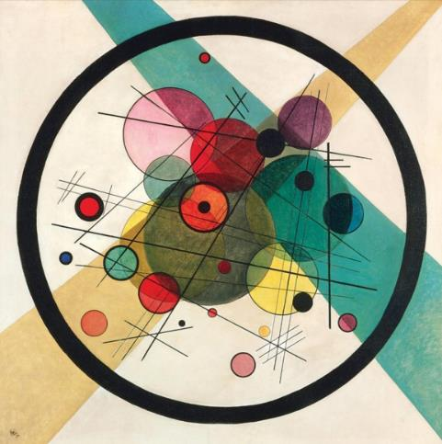
Day 2: Recognise the place value of each digit in a 2-digit number (tens, ones). Add two 2-digit numbers mentally and using pictorial representations.
Expressive art Painting
What is the hidden red number?
What is the total of these two numbers?
What is the hidden green number?
Notes:
Decide which of the red circles to count as large (tens) and which to count as small (ones), e.g. Two big red circles (tens) and eight little red circles (ones) is 28. If the painting also contains 1 big green circle and 3 little green circles, that is 13.

Slide 7
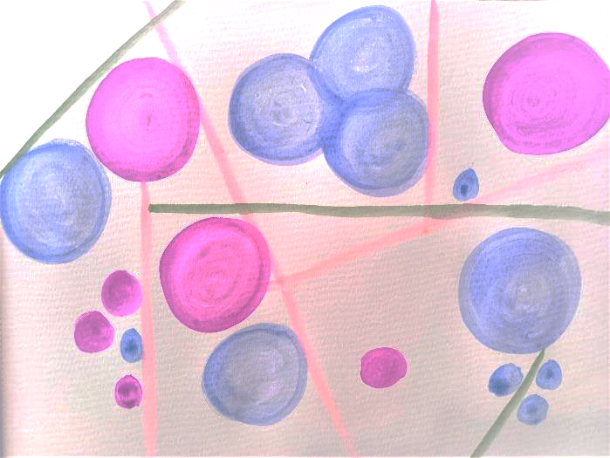
Day 2: Recognise the place value of each digit in a 2-digit number (tens, ones). Add two 2-digit numbers mentally and using pictorial representations.
Expressive art Painting
How could you represent this number in a painting, using circles?
Let’s add a second number to our painting! What number could we paint that when added to 34 would make 99?
34
65

Slide 8
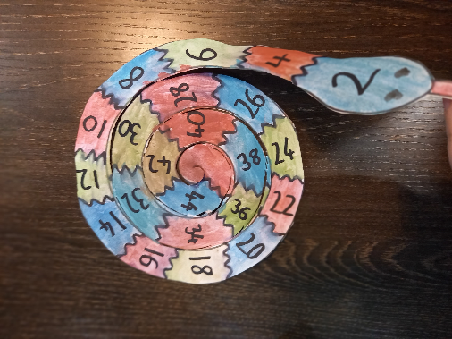
Day 3: Count in steps of 2, 3, and 5 from 0, and in tens from any number, forward and backward.
Expressive art Painting & Papercraft
Can you read the numbers on the snake? What is its pattern?

Slide 9
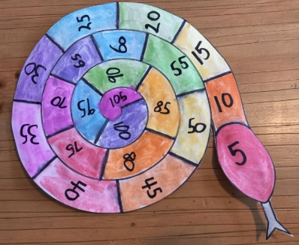
Day 3: Count in steps of 2, 3, and 5 from 0, and in tens from any number, forward and backward.
Expressive art Painting & Papercraft
All spiral number snakes like to have a counting pattern on their backs – it’s their camouflage!
What other number patterns could we make?
Notes:
Practise counting in 5s and 10s… how far can we go?

Slide 10
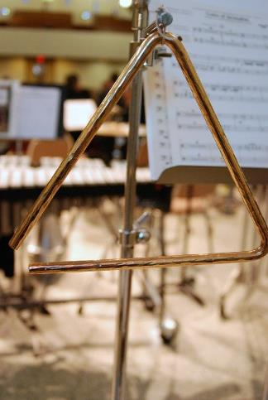
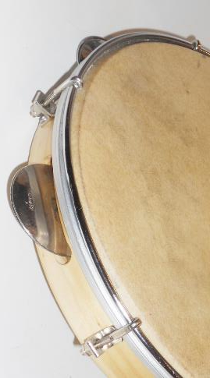
Day 4: Add and subtract numbers using concrete objects, mentally and with pictorial representations, including: a 2-digit number and ones, and two 2-digit numbers.
Expressive art Music
The triangle represents ‘1’s and the tambourine represents ‘10s’.
Can you beat out 24 using your triangle and tambourine?

Slide 11
Day 4: Add and subtract numbers using concrete objects, mentally and with pictorial representations, including: a 2-digit number and ones, and two 2-digit numbers.
Expressive art Music
How many tens altogether?
How many ones altogether?
Can you add the tens and the ones?
Notes:
Beat out a number and challenge each child to writes it down. How many tens altogether? How many ones altogether? Can you add the tens and the ones? Has everyone got the same answer?

Slide 12
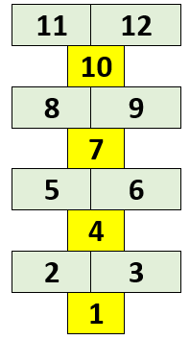
Day 5: Add numbers mentally, including: a two-digit number and ones, two two-digit numbers.
Expressive art Movement
Let’s roll a dice…it’s a 6!
We would land on 8 and 9! Let’s write that down as 89 and roll again!
This time we roll a 2 and land on 11 and 12! I’m going to choose 11 and add it to my 89. How could we add 11?
start
89
+ 11 = 100
Notes:
Throw a dice and make that many jumps/hops along the track. Notice, for example, that six leaps lakes you to 8 and 9. Explain that you are going to choose either 8 or 9, or make them into a 2-digit number: 89 and write it on your whiteboard. Throw the dice again and repeat, adding on the number you land on. For example, if you land on 11-12, choose to add either to your 89. Ask children to help you, discussing possible methods (e.g. add on 10 then 1 or 2 more). 89 + 11 = 100. You win!! The first person to 100 wins.

