Slide 1
Pigs

Slide 2
Pigs are animals that live on farms. They originated from Eurasian Wild Boars.

Slide 3
A young pig is called a piglet.
A male pig is called a boar.
A female pig is called a sow.
A female pig is called a gilt if she has not had any piglets yet.
Pigs are also known as hogs or swine.

Slide 4
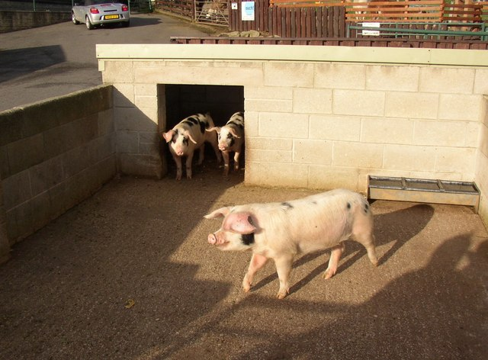
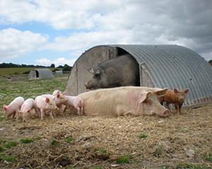
Where do pigs live?
Pigs live in sties also called pig pens. Sometimes pigs are kept in little huts called arks when they live outside on a farm.

Slide 5
Do people keep pigs as pets?
Yes, the most common breed to keep as pets is the Pot Bellied Pig. They are about the size of a medium to large dog.

Slide 6
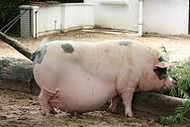
What is the gestational period for a pig?
A sow can give birth to a litter containing 7 to 12 piglets, about twice a year.
A sow’s pregnancy last for 114 days, which is 3 months, 3 weeks and 3 days.

Slide 7
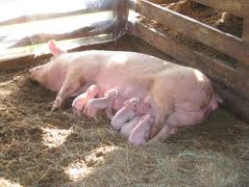
Piglets
A baby pig or piglet weighs about 1.5 kilograms (a bag and a half of sugar) at birth, and will double in weight in just 7 days.
Piglets drink milk from their mothers. They begin to eat solid food at 3 months old, just like human babies.

Slide 8
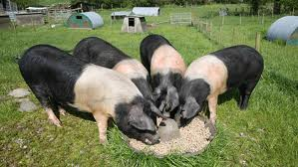
What do pigs eat?
Pigs are omnivores, so they eat meat and plants. They like to eat worms, snakes, pig pellets, corn, cereal and table scraps.
Even though pigs have their feed and table scraps, they never eat too much. They only eat what they need.

Slide 9
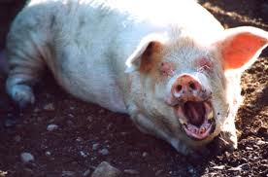
Do pigs have teeth?
Pigs can have 34 or 44 teeth. Some wild pigs have tusks for digging and fighting.

Slide 10
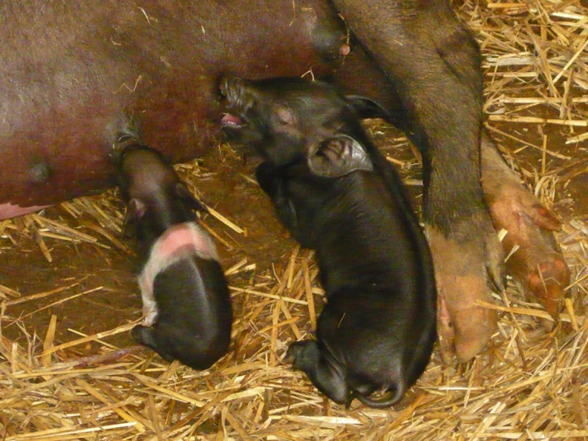
Who is the runt of the litter?
A runt is the smallest and weakest pig of the litter. It usually gets pushed from its mother by its brother and sister.
As the runt is smaller, it will need extra food to help it grow.
The runt is about half the size of its brothers or sisters.

Slide 11
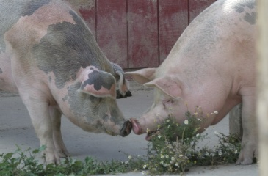
Communication
Pigs make grunting sounds to show that they are happy or to give a warning.
Sometimes they squeal when they are sad.

Slide 12
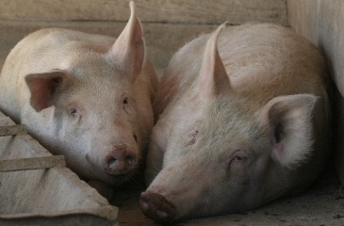
Do pigs make friends?
Pigs are very social animals. They form close bonds with each other and other species. Pigs enjoy close contact and will lie close together when resting.

Slide 13
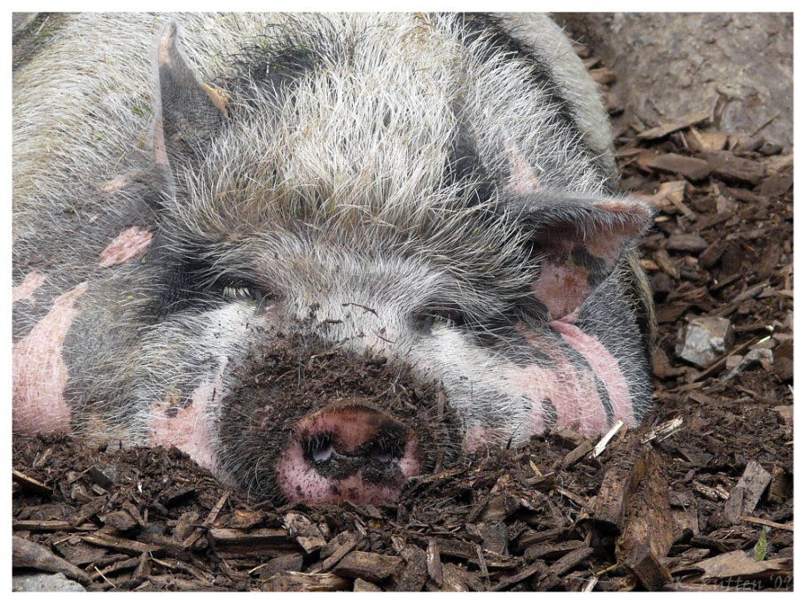
Do pigs sleep?
Yes, they snooze after play. Pigs sleep at night for long periods of time.

Slide 14
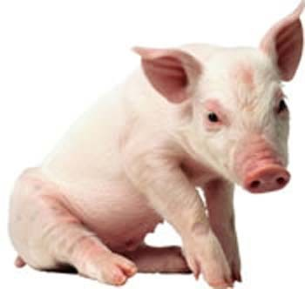
Do pigs have toes?
Yes, pigs have four toes on each foot, but they only walk on the middle two.

Slide 15
What do pig’s tails look like?
Many pigs have wiggly, curly tails.

Slide 16
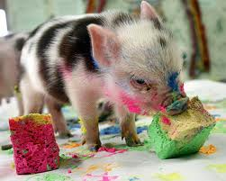
Pig’s senses
Pigs are good at hearing and smelling. They put everything in their mouths and use their sense of taste too.

Slide 17
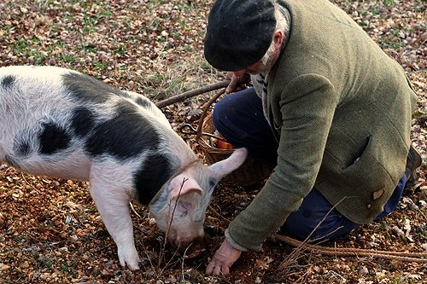
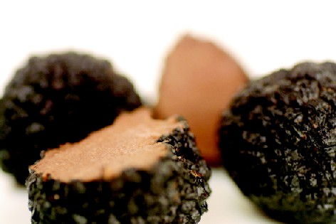
How does a pig use its snout?
A pig uses its snout to root for food and to dig. Pigs in France use their snouts to look for very expensive mushrooms called truffles.

Slide 18
Pigs have poor eyesight and small eyes.

Slide 19
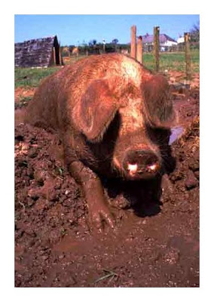
Do pigs sweat?
No, they cannot sweat because they do not have sweat glands.
They roll around in the mud to keep cool. This is called wallowing in the mud.

Slide 20
Different breeds of pig
Gloucester Old Spot
Hampshire

Slide 21
Interesting facts…
Pigs are good swimmers.
A pig can run as fast as thirty miles and hour.
Pigs have very good memories and are really clever.
Nearly 335 million pigs live in China.

