Slide 1
Addition and Subtraction
Mental addition and subtraction
Objectives
Day 1
Know number bonds to 8; Recognise that addition can be done in any order.
Use number facts to add and subtract.
Day 2
Know number bonds to 9; Recognise that addition can be done in any order.
Use number facts and place value to add and subtract.
Day 3
Relate addition and subtraction number facts.
Add a single-digit number to a 2-digit number, bridging 10.
Day 4
Add three numbers, using number bonds to 10.
Subtract a single-digit number from a 2-digit number, bridging 10.
Day 5
Add three numbers, using doubles and number bonds.
Add three, four or five numbers, using doubles and number bonds.
Notes:
Before teaching, be aware that:
On Day 1 you will need cubes, ‘How many more to make 8’ cube bar model (see resources), sticky notes, 20 bead frame (2 rows of 10).
On Day 2 you will need cubes, calculations written on cards or on IWB, bead bar, place value cards.
On Day 3 children will need mini-whiteboards and pens. You will need 10 pegs (5 one colour and 5 a different colour), coat hanger, cloth, bead bar, large 0 to 100 beaded line, 0 to 100 landmarked line (see resources).
On Day 4 you will need 1 – 6 dotty dice, digit cards, 100-bead bar, 1 to 100 number grid (see resources), subtraction calculations (see below) written on cards or IWB.
On Day 5 children will need mini-whiteboards and pens. You will need dice 2 packs of 0–9 digit-cards, 0 to 20 beaded line (see resources).

Slide 2
Addition and Subtraction
Mental addition and subtraction
Short Mental Workouts
Day 1
Pairs to 6
Day 2
Pairs to 7
Day 3
Pairs to 10
Day 4
Pairs to 10
Day 5
Doubles
Notes:
Choose Workouts that suit your class by dragging and dropping the relevant slide or slides below to the start of the teaching for each day.

Slide 3
Addition and Subtraction
Mental addition and subtraction
Short Mental Workout
Pairs to 6
Notes:
To use this activity, drag this slide to the start of Day 1
Play ‘Ping Pong’ with the children. You say a number under 6, e.g. 2. Children say a number to complete the bond to 6, e.g. 4. Keep the pace quick and see how many they can manage without going wrong. Sometimes say Ping, children say Pong.

Slide 4
Addition and Subtraction
Mental addition and subtraction
Short Mental Workout
Pairs to 7
Notes:
To use this activity, drag this slide to the start of Day 2
Children put their hands behind their backs. Show 3 fingers. Children show the number of fingers that are needed to make 7 when you say Show me! Repeat, showing other numbers of fingers from 0 to 7. Try to build up speed.

Slide 5
Addition and Subtraction
Mental addition and subtraction
Short Mental Workout
Pairs to 10
Notes:
To use this activity, drag this slide to the start of Day 3
Show 10 pegs (5 in each colour) on a hanger. Practise the pairs that make 10 by hiding pegs with a cloth. Children use their fingers to help find the missing number. Turn the hanger around to show the reverse for each pair, e.g. 7 + 3, 3 + 7. Repeat with other pairs to 10.

Slide 6
Addition and Subtraction
Mental addition and subtraction
Short Mental Workout
Pairs to 10
Notes:
To use this activity, drag this slide to the start of Day 4
Children put their hands behind their backs. Show 3 fingers. How many more to make 10? Children bring hands from behind their backs and show 7. Repeat with other pairs to 10 in random order, trying to keep the pace brisk.

Slide 7
Addition and Subtraction
Mental addition and subtraction
Short Mental Workout
Doubles
Notes:
To use this activity, drag this slide to the start of Day 5
Children choose 4 numbers from 1–10 to write on whiteboards. Roll a 1–6 dice (if a 6, roll again). Children use fingers to double the number. They ring the answer if they have it. The first child to ring all their numbers wins. Play again with children choosing new numbers. Will you ever be able to ring 3? Why not? What are the best numbers to choose?

Slide 8
Addition and Subtraction
Mental addition and subtraction
Objectives
Day 1
Know number bonds to 8; Recognise that addition can be done in any order.
Use number facts to add and subtract.

Slide 9
Day 1: Know number bonds to 8; Recognise that addition can be done in any order. Use number facts to add and subtract.
Look at this number sentence...
Knowing number bonds will help us when we add.
3 + ☐ = 8
Talk to your partner...
What is the missing number?
How will you find out?
Notes:
Teaching with Y1 and Y2
Tell children it is useful to know lots of ‘number bonds’ for different numbers to help them when they are adding.

Slide 10
Day 1: Know number bonds to 8; Recognise that addition can be done in any order. Use number facts to add and subtract.
Did you…
…count on from 3
to get to 8?
…look at your fingers?
…do it a different way?

Slide 11
Day 1: Know number bonds to 8; Recognise that addition can be done in any order. Use number facts to add and subtract.
We can also show this sum using cubes.
How many more red cubes are needed to make 8?
3 + = 8
5

Slide 12
Day 1: Know number bonds to 8; Recognise that addition can be done in any order. Use number facts to add and subtract.
Think back to the number sentence before.
☐
3+ = 8
5
What number should go in the box now?
☐
5+ = 8
3

Slide 13
Day 1: Know number bonds to 8; Recognise that addition can be done in any order. Use number facts to add and subtract.
3 and 5 are ‘special’ number partners that make 8:
a number bond.
5
3
3 + 5 = 8
Addition can be done in any order because the two parts being added haven’t changed, so must make the same whole.
5 + 3 = 8

Slide 14
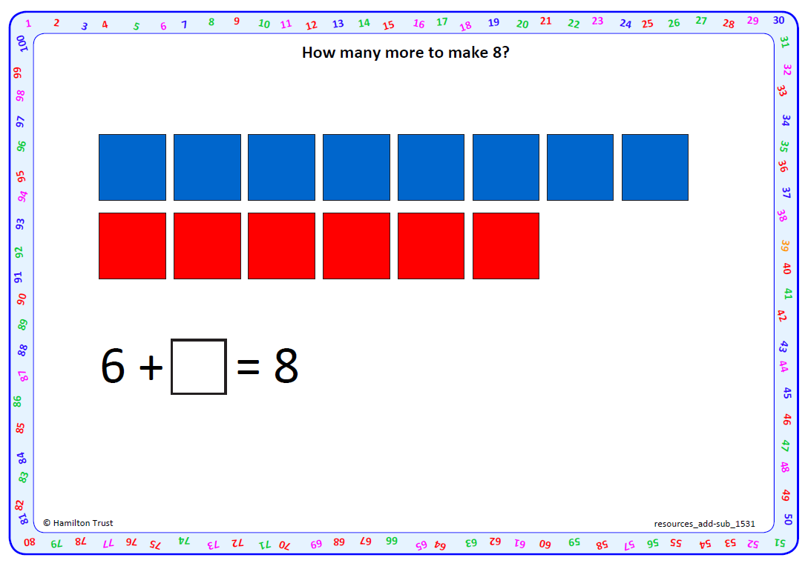
Day 1: Know number bonds to 8; Recognise that addition can be done in any order. Use number facts to add and subtract.
2
How many more red cubes are needed to make 8?

Slide 15
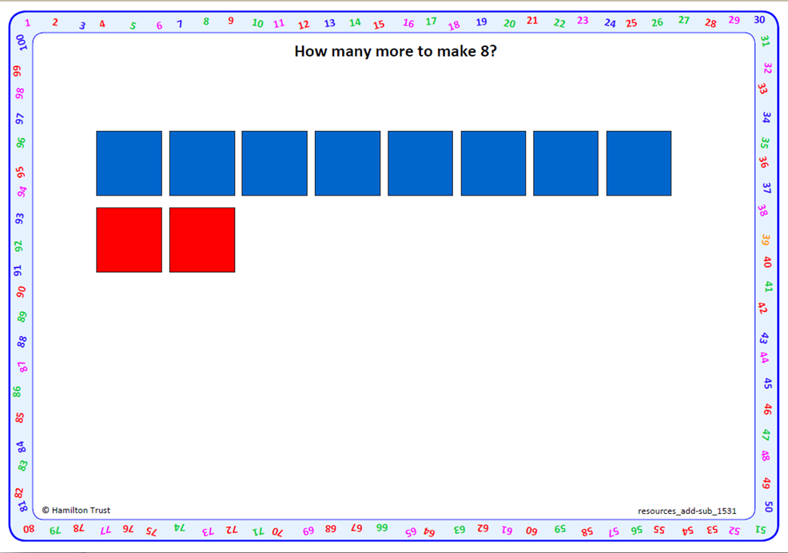
Day 1: Know number bonds to 8; Recognise that addition can be done in any order. Use number facts to add and subtract.
FINAL SLIDE for combined teaching
6
2 + = 8
Now how many more red cubes are needed to make 8?

Slide 16
Day 1: Know number bonds to 8; Recognise that addition can be done in any order. Use number facts to add and subtract.
Talk to your partner.
Can you find any other pairs of numbers that total 8?
Take feedback and ask children to add their number sentence to a large class piece of paper.
Notes:
Make sure all bonds to 8 are shown, including 8 + 0 = 8.
Y1 children can now go on to do differentiated GROUP ACTIVITIES. You can find Hamilton’s group activities in this unit’s TEACHING AND GROUP ACTIVITIES download.
WT/ARE: Find the matching number to make 8.
GD: Order number bonds to 8; find matching number bonds partners.

Slide 17
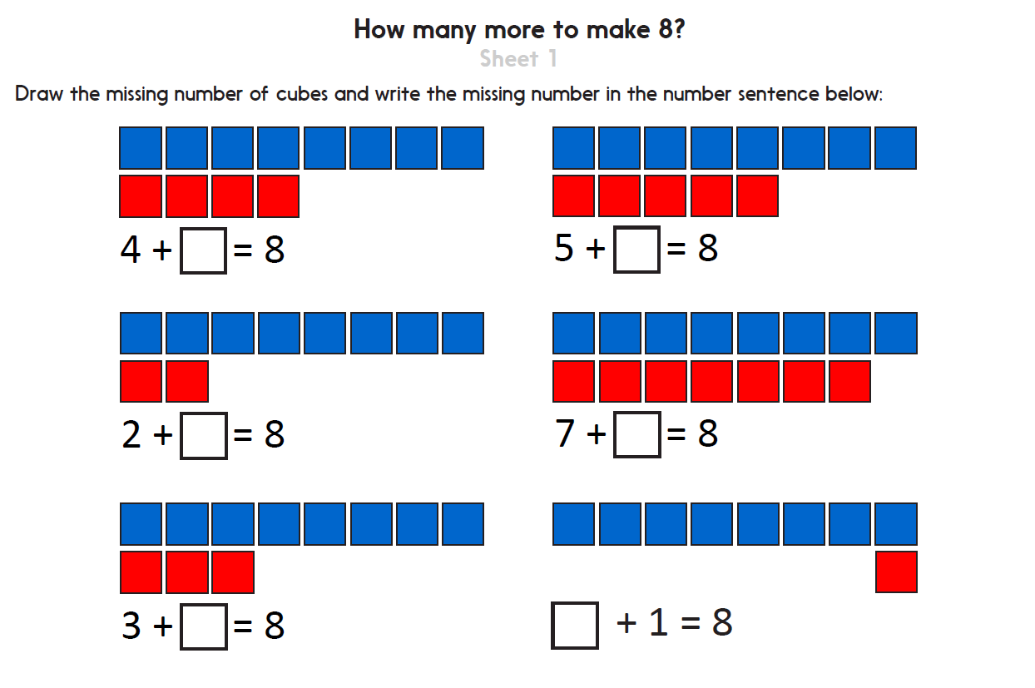
Notes:
The Practice Sheet on this slide is suitable for most Y1 children.
Differentiated PRACTICE WORKSHEETS are available on Hamilton’s website in this unit’s PROCEDURAL FLUENCY box.
WT/ARE/GD: Draw missing cubes to complete number bonds to 8. Sheet 1

Slide 18
Day 1: Use number facts to add and subtract.
What is 5 add 2?
We only needed to know one number fact (5 + 2) to find
15 + 2...
What is 15 add 2?
Notes:
Further teaching for Y2

Slide 19
Day 1: Use number facts to add and subtract.
What is 6 add 3?
We only needed to know one number fact (6 + 3) to find 16 + 3.
What is 16 add 3?

Slide 20
Day 1: Use number facts to add and subtract.
What is 5 take away 2?
If we know what
5 - 2 is, then we can use this fact to find
15 – 2.
So what is 15 take away 2?

Slide 21
Day 1: Use number facts to add and subtract.
FINAL SLIDE for single Year teaching
What is 6 take away 3?
If we know what
6 - 3 is, then we can use this fact to find
16 – 3.
So what is 16 take away 3?
Notes:
Y2 children can now go on to do differentiated GROUP ACTIVITIES. You can find Hamilton’s group activities in this unit’s TEACHING AND GROUP ACTIVITIES download.
WT: Solve additions using number facts, focusing on place value of 10s digit.
ARE/GD: Solve additions and subtractions using number facts given on cards.

Slide 22
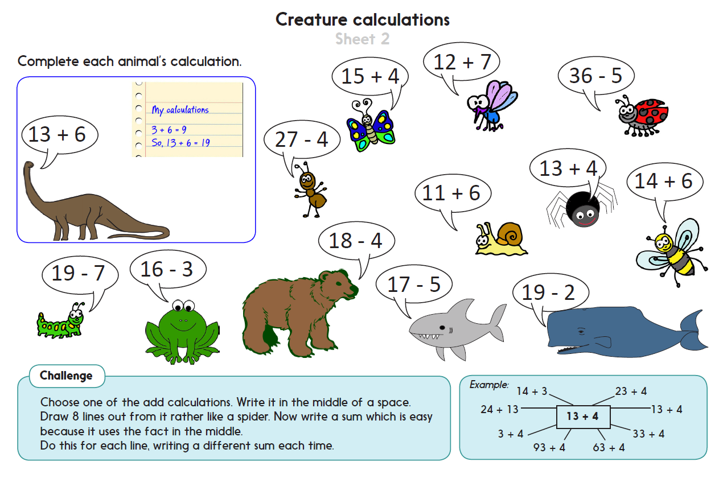
Challenge
Notes:
The Practice Sheet on this slide is suitable for most Y2 children.
Differentiated PRACTICE WORKSHEETS are available on Hamilton’s website in this unit’s PROCEDURAL FLUENCY box.
WT/ARE: Children show how to solve addition and subtraction problems using number facts. Sheet 2
GD: Children show how to solve addition and subtraction problems using number facts. Sheet 3

Slide 23
Addition and Subtraction
Mental addition and subtraction
Objectives
Day 2
Know number bonds to 9; Recognise that addition can be done in any order.
Use number facts and place value to add and subtract.

Slide 24
Day 2: Know number bonds to 9; Recognise that addition can be done in any order.
Use number facts and place value to add and subtract.
35 + 3
27 – 7
30 + 5
46 + 6
27 – 5
56 + 3
99 – 3
Y1: What is 5 + 3?
Y2: Can you see an addition where you could use this fact?
Number facts
35 + 3
Notes:
Teaching with Y1 and Y2

Slide 25
Day 2: Know number bonds to 9; Recognise that addition can be done in any order.
Use number facts and place value to add and subtract.
27 – 7
30 + 5
46 + 6
27 – 5
56 + 3
99 – 3
Y2: Which strategies would you use to solve these calculations?
We can use number facts to solve 27 - 5.
We can use place value to solve 30 + 5.
Number facts
Place value
(we could show it with PV cards)
35 + 3
27 – 5
30 + 5

Slide 26
Day 2: Know number bonds to 9; Recognise that addition can be done in any order.
Use number facts and place value to add and subtract.
27 – 7
46 + 6
56 + 3
99 – 3
Talk to your partner.
Can see others where you would use place value?
Talk to your partner.
Can see others where you would use a number fact?
Number facts
Place value
(we could show it with PV cards)
35 + 3
27 – 5
30 + 5
27 – 7
99 – 3
46 + 6
56 + 3
Notes:
Show on bead bar if necessary.
Y2 children can now go on to do differentiated GROUP ACTIVITIES. You can find Hamilton’s group activities in this unit’s TEACHING AND GROUP ACTIVITIES download.
WT/ARE: Sort calculations according to the strategy used to solve them.
GD: Investigate equality using an on-screen interactivity.

Slide 27
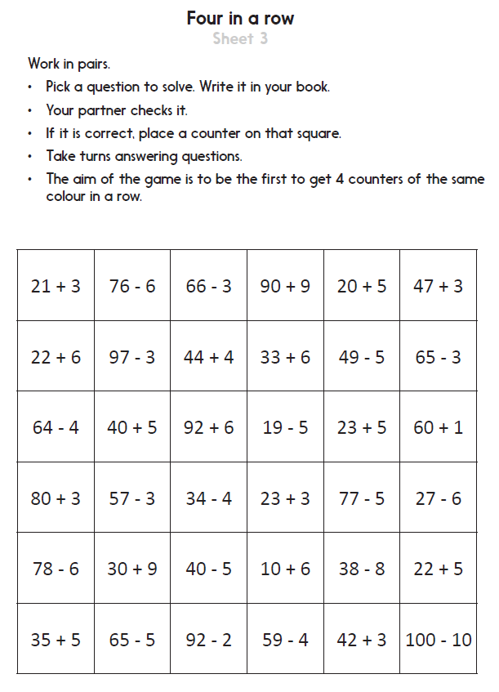
Notes:
The Practice Sheet on this slide is suitable for most Y2 children.
Differentiated PRACTICE WORKSHEETS are available on Hamilton’s website in this unit’s PROCEDURAL FLUENCY box.
WT: Card Race: Solve addition and subtraction calculations to win a cup! Sheet 2
ARE/GD: Solve addition and subtraction calculations to play a game of 4-in-a-row. Sheet 3

Slide 28
Day 2: Know number bonds to 9; Recognise that addition can be done in any order.
9 + 0
3 + 6
They are all number bonds to 9!
What do all these number sentences have in common?
7 + 2
4 + 5
8 + 1
Notes:
Further teaching with Y1

Slide 29
Day 2: Know number bonds to 9; Recognise that addition can be done in any order.
9 + 0
Remember… Addition can be done in any order because the two parts being added haven’t changed, so must make the same total.
3 + 6
7 + 2
Can we find any more number bonds to 9, using these same numbers?
4 + 5
8 + 1

Slide 30
Day 2: Know number bonds to 9; Recognise that addition can be done in any order.
9 + 0
0 + 9
3 + 6
6 + 3
7 + 2
2 + 7
We can use these to help write subtraction number bonds.
4 + 5
5 + 4
8 + 1
1 + 8

Slide 31
Day 2: Know number bonds to 9; Recognise that addition can be done in any order.
9 + 0
0 + 9
3 + 6
6 + 3
9 – 4 = □
7 + 2
2 + 7
Can you use any of these number bonds to help find the missing number?
4 + 5
5 + 4
8 + 1
1 + 8

Slide 32
Day 2: Know number bonds to 9; Recognise that addition can be done in any order.
4 and 5 are special partners so let’s try that.
Yes! That works.
9 – 4 =
5
Use cubes to demonstrate.

Slide 33
Day 2: Know number bonds to 9; Recognise that addition can be done in any order.
9 + 0
0 + 9
3 + 6
6 + 3
9 – 2 = □
7 + 2
2 + 7
What about this subtraction?
Which number bond to 9 contains a 2?
4 + 5
5 + 4
8 + 1
1 + 8

Slide 34
Day 2: Know number bonds to 9; Recognise that addition can be done in any order.
9 + 0
0 + 9
3 + 6
6 + 3
9 – 2 =
7
7 + 2
2 + 7
4 + 5
5 + 4
Complete the number sentence with your partner.
8 + 1
1 + 8

Slide 35
Day 2: Know number bonds to 9; Recognise that addition can be done in any order.
9 + 0
0 + 9
Find more subtraction number bonds to 9 with your partner.
3 + 6
6 + 3
7 + 2
2 + 7
4 + 5
5 + 4
8 + 1
1 + 8
Notes:
Y1 children can now go on to do differentiated GROUP ACTIVITIES. You can find Hamilton’s group activities in this unit’s TEACHING AND GROUP ACTIVITIES download.
WT/ARE/GD: Make number bonds to 9 with cubes in a feely bag.
ARE/GD: Play a game creating number bond number sentences with a partner.

Slide 36
Notes:
The Practice Sheet on this slide is suitable for most Y1 children.
Differentiated PRACTICE WORKSHEETS are available on Hamilton’s website in this unit’s PROCEDURAL FLUENCY box.
WT/ARE/GD: Calculate how many more candles each cake would need to have 9 candles in total. Sheet 1

Slide 37
Addition and Subtraction
Mental addition and subtraction
Objectives
Day 3
Relate addition and subtraction number facts.
Add a single-digit number to a 2-digit number, bridging 10.

Slide 38
Day 3: Relate addition and subtraction number facts. Add a single-digit number to a 2-digit number, bridging 10.
With a partner, write number bonds to 8 on your whiteboard, e.g.
4 + 4 = 8.
These are all addition number sentences.
We can use these number facts to help us make subtraction number sentences too.

Slide 39
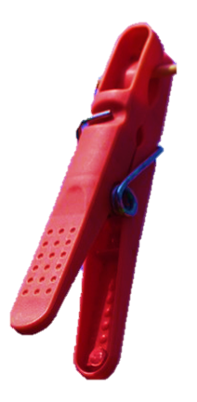
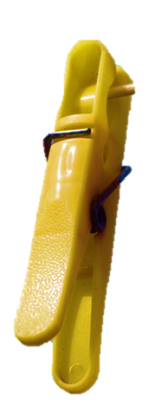
Day 3: Relate addition and subtraction number facts. Add a single-digit number to a 2-digit number, bridging 10.
If I take these 2 pegs off, how many will be left?
How many pegs altogether?
Show children 6 pegs of one colour and 2 of another on a coat hanger.
8
6

Slide 40
Day 3: Relate addition and subtraction number facts. Add a single-digit number to a 2-digit number, bridging 10.
What number sentence can we write?
8 – 2 = 6

Slide 41
Day 3: Relate addition and subtraction number facts. Add a single-digit number to a 2-digit number, bridging 10.
2 + 6 = 8
The numbers are the same as those in the addition number sentences.
They have just been moved around.
6 + 2 = 8
8 - 2 = 6

Slide 42
Day 3: Relate addition and subtraction number facts. Add a single-digit number to a 2-digit number, bridging 10.
What if I took the 6 off instead?

Slide 43
Day 3: Relate addition and subtraction number facts. Add a single-digit number to a 2-digit number, bridging 10.
There are 2 left.
8 – 6 = 2

Slide 44
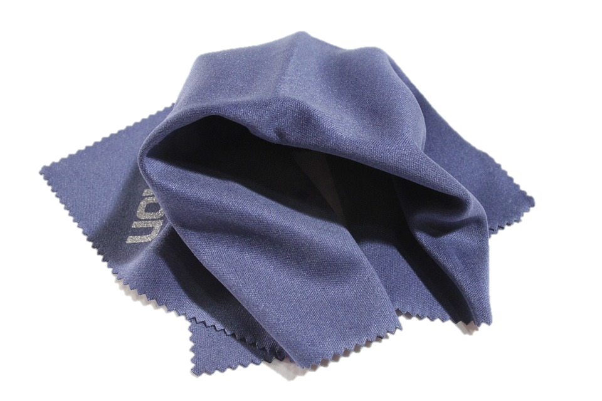
Day 3: Relate addition and subtraction number facts. Add a single-digit number to a 2-digit number, bridging 10.
How many pegs under the cloth?
There are still 8 pegs. If I take these 3 off, how many will be left?
Close your eyes!
5
Notes:
Reveal the pegs to check.

Slide 45
Day 3: Relate addition and subtraction number facts. Add a single-digit number to a 2-digit number, bridging 10.
What number sentences can we write?
8 - 3 = 5
5 + 3 = 8
3 + 5 = 8
Repeat, showing 8-2, 8-4, 8-5 and 8-7.
Encourage children to write subtractions by making connections to addition number facts.
Notes:
Y1 children can now go on to do differentiated GROUP ACTIVITIES. You can find Hamilton’s group activities in this unit’s TEACHING AND GROUP ACTIVITIES download.
WT/ARE/GD: Make snakes of 8 and 9 cubes in 2 colours and record as a subtraction.

Slide 46
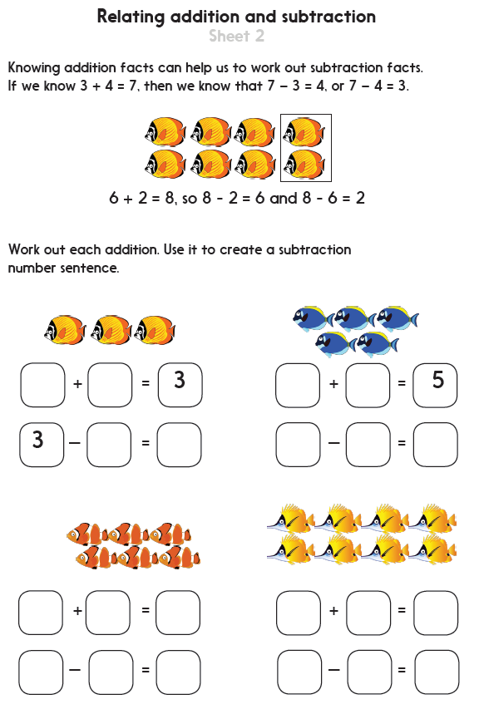
Notes:
The Practice Sheet on this and the next slide are suitable for most Y1 children.
Differentiated PRACTICE WORKSHEETS are available on Hamilton’s website in this unit’s PROCEDURAL FLUENCY box.
WT: Relate adding and subtracting: use addition facts to create subtraction number sentences. Sheet 1
ARE/GD: Relate adding and subtracting: use addition facts to create subtraction number sentences. Sheet 2 and 3

Slide 47
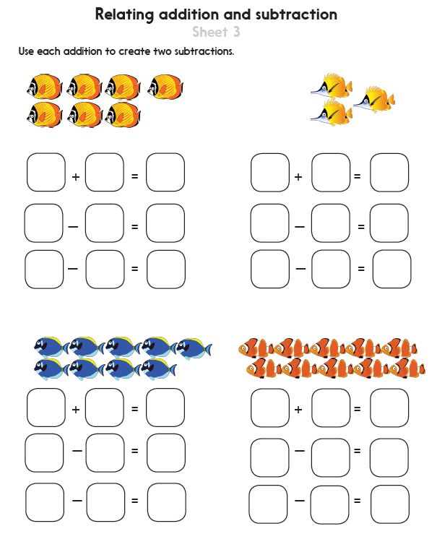
Notes:
The Practice Sheet on this and the previous slide are suitable for most Y1 children.
Differentiated PRACTICE WORKSHEETS are available on Hamilton’s website in this unit’s PROCEDURAL FLUENCY box.
WT: Relate adding and subtracting: use addition facts to create subtraction number sentences. Sheet 1
ARE/GD: Relate adding and subtracting: use addition facts to create subtraction number sentences. Sheet 2 and 3

Slide 48
Day 3: Add a single-digit number to a 2-digit number, bridging 10.
We are going to add 5 beads.
See how 2 beads make 30, then 3 more beads make 33?
28 + 5 = 33
Let’s call this strategy
‘Target the 10s’
or T10 for short…
Notes:
Further teaching with Y2
Explain that you are trying to land on a multiple of 10 to help add the single-digit number.

Slide 49
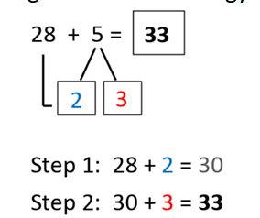
Day 3: Add a single-digit number to a 2-digit number, bridging 10.
This is how we record the T10 strategy.

Slide 50
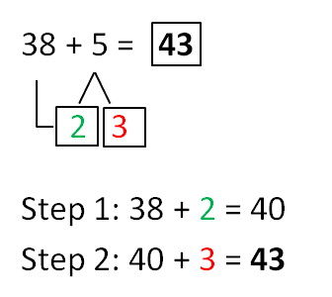
Day 3: Add a single-digit number to a 2-digit number, bridging 10.
Let’s add again, starting with 38 beads.

Slide 51
Day 3: Add a single-digit number to a 2-digit number, bridging 10.
How many beads do we need to make 30?
We are going to find 26 + 7.
+4
+3
26
33
What is the answer?
How many more do we need to add?

Slide 52
Day 3: Add a single-digit number to a 2-digit number, bridging 10.
We are going to calculate 26 + 7.
How many beads do we need to make 30?
+4
+3
26
33
What is the answer?
Where is that on the line?
How many more do we need to add?

Slide 53
Day 3: Add a single-digit number to a 2-digit number, bridging 10.
We are going to calculate 45 + 7.
Draw a label after the 45th bead.
How many more do we need to add?
How many beads to the next 10?
What is the answer?

Slide 54
Day 3: Add a single-digit number to a 2-digit number, bridging 10.
How many beads do we need to make 50?
We are going to calculate 45 + 7.
+5
+2
45
52
What is the answer?
Where is that on the line?
How many more do we need to add?
Notes:
Y2 children can now go on to do differentiated GROUP ACTIVITIES. You can find Hamilton’s group activities in this unit’s TEACHING AND GROUP ACTIVITIES download.
WT: Children develop understanding of bridging 10 when adding a 1-digit number to a 2-digit number using beaded lines or landmarked lines.
ARE/GD: Children develop understanding of bridging 10 when adding a 1-digit number to a 2-digit number using beaded lines or landmarked lines.

Slide 55
Challenge
Notes:
The Practice Sheet on this slide is suitable for most Y2 children.
Differentiated PRACTICE WORKSHEETS are available on Hamilton’s website in this unit’s PROCEDURAL FLUENCY box.
WT/ARE/GD: Train Journey: adding single digit numbers to keep a running total of the number of passengers on a train. Sheet 4

Slide 56
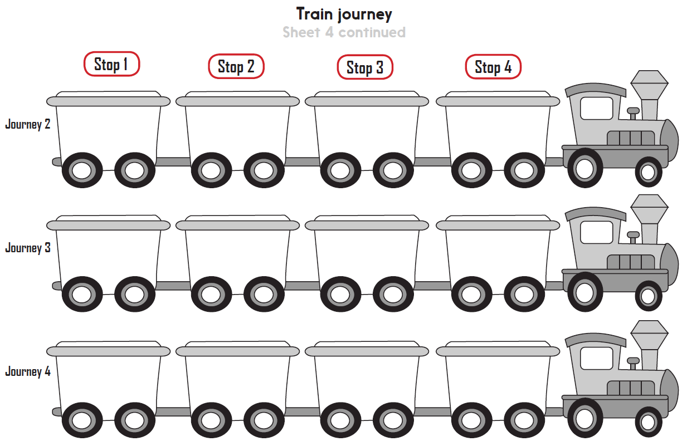
Notes:
The Practice Sheet on this slide is suitable for most Y2 children.
Differentiated PRACTICE WORKSHEETS are available on Hamilton’s website in this unit’s PROCEDURAL FLUENCY box.
WT/ARE/GD: Train Journey: adding single digit numbers to keep a running total of the number of passengers on a train. Sheet 4

Slide 57
Addition and Subtraction
Mental addition and subtraction
Objectives
Day 4
Add three numbers, using number bonds to 10.
Subtract a single-digit number from a 2-digit number, bridging 10.

Slide 58
Day 4: Add three numbers, using number bonds to 10. Subtract a single-digit number from a 2-digit number, bridging 10.
What is the total number of spots on these first two dice?
What is 10 add another 3?
10
13
Notes:
Teaching with Y1 and Y2
Encourage children to use their knowledge of number facts (i.e. they know that 0 + 3 = 3, so 10 + 3 = 13) and to start at 10 and count on if they don’t just ‘know’ the answer, rather than counting all 10 again and then 3 more.

Slide 59
Day 4: Add three numbers, using number bonds to 10. Subtract a single-digit number from a 2-digit number, bridging 10.
How did you add them?
What is the total?
Is there an efficient order to do it?
12

Slide 60
Day 4: Add three numbers, using number bonds to 10. Subtract a single-digit number from a 2-digit number, bridging 10.
Day 4: Add three numbers, using number bonds to 10. Subtract a single-digit number from a 2-digit number, bridging 10.
Let’s add them now…
5 add 5 makes 10, then another 2 makes 12.
Notes:
Emphasise that you get the same answer when we move them around, but this is a more efficient order to add them. We found the pair to 10.
Y1 children can now go on to do differentiated GROUP ACTIVITIES. You can find Hamilton’s group activities in this unit’s TEACHING AND GROUP ACTIVITIES download.
WT/ARE/GD: Play a game of skittles, adding 3 numbers to find the total.

Slide 61
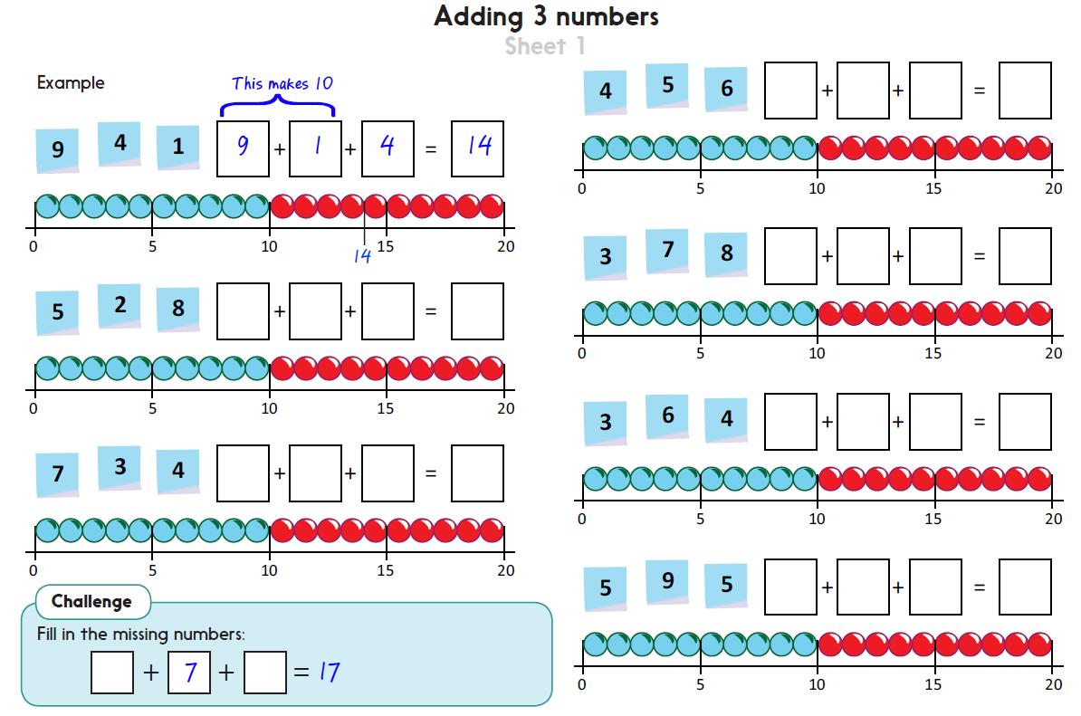
Challenge
Notes:
The Practice Sheet on this slide is suitable for most Y1 children.
Differentiated PRACTICE WORKSHEETS are available on Hamilton’s website in this unit’s PROCEDURAL FLUENCY box.
WT/ARE: Add 3 numbers, spotting pairs to 10, using beaded lines for support. Sheet 1
GD: Add 3 numbers, reordering to add efficiently. Sheet 2

Slide 62
Day 4: Subtract a single-digit number from a 2-digit number, bridging 10.
Remember that these are special numbers.
26
32 – 6 =
26
If we count back 6, we will cross a multiple of ten (30).
This is the opposite of when we were adding.
Notes:
Further teaching for Y2
Count back 2 in one step (to 30) and then 4 in one step (to 26) on the grid.
Also show on the 100 bead bar.

Slide 63
Day 4: Subtract a single-digit number from a 2-digit number, bridging 10.
Remember that these are special numbers.
26
45 – 7 =
38
If we count back 7, we will cross a multiple of ten (40).
Notes:
Count back 5 in one step (to 30) and then 2 in one step (to 26) on the grid.
Also show on the 100 bead bar.

Slide 64
Day 4: Subtract a single-digit number from a 2-digit number, bridging 10.
Which will cross a ‘red’ number on the 100-grid; that is, they will ‘break’ into the next group of 10 beads down on a bead bar?
27 – 5
22 – 5
33 – 4
Don’t cross a 10s number
Cross a 10s number
27 – 5
22 – 5
33 – 4
Notes:
Y2 children can now go on to do differentiated GROUP ACTIVITIES. You can find Hamilton’s group activities in this unit’s TEACHING AND GROUP ACTIVITIES download.
WT/ARE: Children sort and solve subtractions by bridging 10, using 1 to 100 number grids, beaded or landmarked lines.
GD: Children sort and solve subtractions by bridging 10, using 1 to 100 number grids, beaded or landmarked lines.

Slide 65
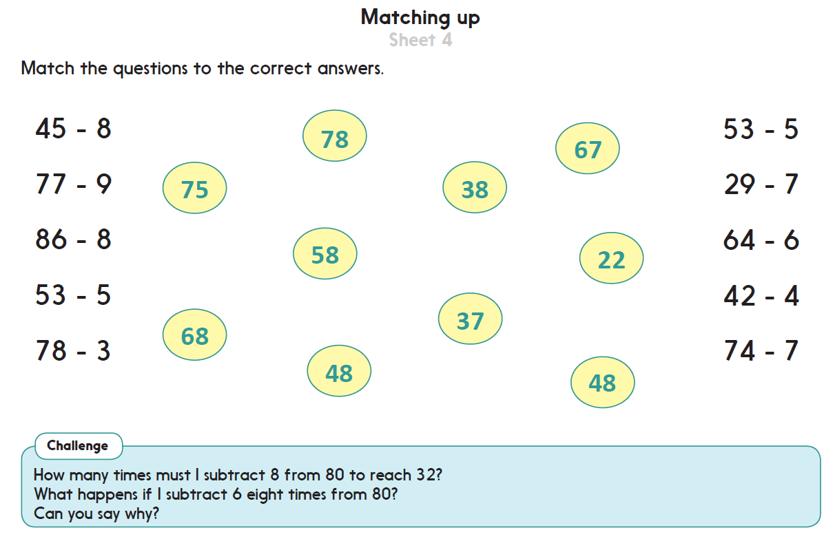
Challenge
Notes:
The Practice Sheet on this slide is suitable for most Y2 children.
Differentiated PRACTICE WORKSHEETS are available on Hamilton’s website in this unit’s PROCEDURAL FLUENCY box.
WT: Match subtraction calculations to correct answers by counting back or using number facts. Sheet 3
ARE/GD: Match subtraction calculations to correct answers by counting back or using number facts. Sheet 4

Slide 66
Addition and Subtraction
Mental addition and subtraction
Objectives
Day 5
Add three numbers, using doubles and number bonds.
Add three, four or five numbers, using doubles and number bonds.

Slide 67
Day 5: Add three numbers, using doubles and number bonds. Add three, four or five numbers, using doubles and number bonds.
Now we need to calculate 8 add 3.
What is double 4?
There isn’t a pair to 10, but there are two 4s.
Shuffle 2 packs of 0-9 digit cards, then take 4, 3 and 4.
Is there an efficient way to add these?
4
3
4
8
Notes:
Teaching with Y1 and Y2

Slide 68
Day 5: Add three numbers, using doubles and number bonds. Add three, four or five numbers, using doubles and number bonds.
+ 3
8
11
Where have we landed?
4 + 4 + 3 = 11

Slide 69
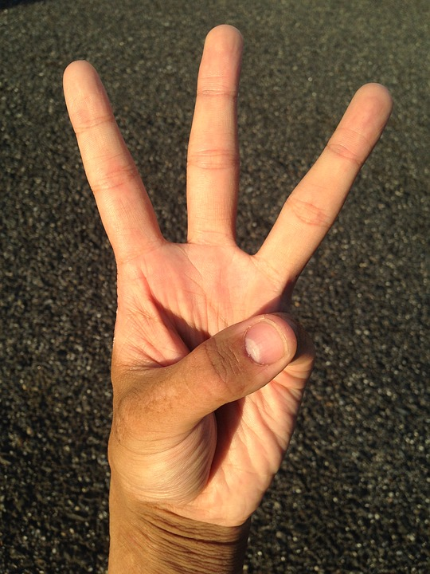
Day 5: Add three numbers, using doubles and number bonds. Add three, four or five numbers, using doubles and number bonds.
Hold 3 fingers up.
We had 8 so now we count on 3...
Now try finding 8 + 3 by counting on your fingers.
9 10 11

Slide 70
Day 5: Add three numbers, using doubles and number bonds. Add three, four or five numbers, using doubles and number bonds.
9 is quite a big number to count on at the end, so let’s put it first.
Take out another set of 3 cards.
There isn’t a pair to 10 or a double this time.
How could we add them?
2
3
9

Slide 71
Day 5: Add three numbers, using doubles and number bonds. Add three, four or five numbers, using doubles and number bonds.
+ 3
+ 2
9
14
Where have we landed?
9 + 3 + 2 = 14

Slide 72
Day 5: Add three numbers, using doubles and number bonds. Add three, four or five numbers, using doubles and number bonds.
6
5
+
+
5
5
+
+
3
6
+
+
5
4
+
+
4
3
=
=
10
+
10
+
3
=
Talk to your partner.
How can we change the order to make it easier? Are there any number facts that can help?
Wow! That’s a long number sentence! We could just add the numbers one at a time, but changing the order would make it easier.
20
+
3
=
23
Let’s move the numbers around and see how see how it helps.
…and then add the 10s…
Now we can add the pairs that make 10…
…Finally we can add the 3 to the 20.
Notes:
Today would be a great day for Y1 to use a problem-solving investigation – Cross sums – as the group activity, which you can find on the next slides and in this unit’s IN-DEPTH INVESTIGATION box on Hamilton’s website.
Alternatively, Y1 and Y2 children can now go on to do differentiated GROUP ACTIVITIES. You can find Hamilton’s group activities in this unit’s TEACHING AND GROUP ACTIVITIES download.
Y1 WT: Roll 3 dotty dice; discuss an efficient strategy to find the total.
Y1 ARE/GD: Select 3 numbers from 1-9 digit cards and/or 1-6 dice; choose an efficient order to add them.
Y2 WT/ARE: Roll 3 or more dice to add; identify pairs to 10, doubles, and number facts to help add them.
Y2 ARE/GD: Pick 4 or more 1 to 10 number cards to add; identify pairs to 10, doubles, and number facts to help add them.

Slide 73
Investigation:
Adult Sheet
Notes:
Today would be a great day to use this problem-solving investigation – Cross Sums – as the group activity, which you can find in this unit’s IN-DEPTH INVESTIGATION box on Hamilton’s website.

Slide 74
Investigation: Child Sheet
Notes:
Today would be a great day to use this problem-solving investigation – Cross Sums – as the group activity, which you can find in this unit’s IN-DEPTH INVESTIGATION box on Hamilton’s website.

Slide 75
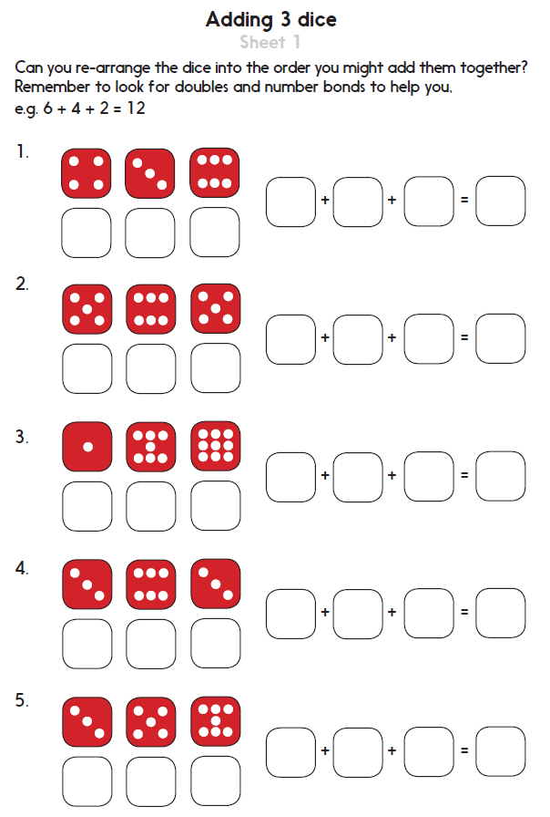
Notes:
The Practice Sheet on this slide is suitable for most Y1 children.
Differentiated PRACTICE WORKSHEETS are available on Hamilton’s website in this unit’s PROCEDURAL FLUENCY box.
WT/ARE: Add numbers on 3 dice, to add efficiently. Sheet 1
GD: Add numbers on 3 dice, to add efficiently. Sheet 2

Slide 76
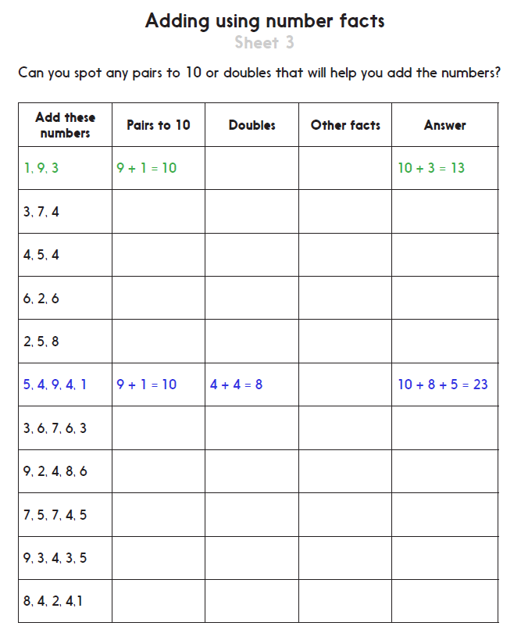
Notes:
The Practice Sheet on this slide is suitable for most Y2 children.
Differentiated PRACTICE WORKSHEETS are available on Hamilton’s website in this unit’s PROCEDURAL FLUENCY box.
WT/ARE: Look for known number facts to help efficiently add a series of single-digit numbers. Sheet 3
GD: Look for known number facts to help efficiently add a series of single-digit numbers. Sheet 4

Slide 77
Addition and Subtraction
Mental addition and subtraction
Well Done! You’ve completed this unit.
Objectives
Day 1
Know number bonds to 8; Recognise that addition can be done in any order.
Use number facts to add and subtract.
Day 2
Know number bonds to 9; Recognise that addition can be done in any order.
Use number facts and place value to add and subtract.
Day 3
Relate addition and subtraction number facts.
Add a single-digit number to a 2-digit number, bridging 10.
Day 4
Add three numbers, using number bonds to 10.
Subtract a single-digit number from a 2-digit number, bridging 10.
Day 5
Add three numbers, using doubles and number bonds.
Add three, four or five numbers, using doubles and number bonds.
Notes:
You can now use the Mastery: Reasoning and Problem-Solving questions to assess children’s success across this unit. Go to the next slides.

Slide 78
Problem solving and reasoning questions
Year 1
Point at the first number and count on.
5 + ☐ = 9 6 + ☐ = 8
☐ + 6 = 9 3 + ☐ = 8
☐ + 2 = 9 1 + ☐ = 8
9 frogs in the pond. 3 hop out. How many now?
8 beetles on a leaf. 5 fly away. How many now?
Choose 3 numbers:
[7] [3] [5] [4] [7] [6]
Choose an efficient strategy to add them. Write the answer.
Tell me why you added them in that order.
Choose three more and do it again…

Slide 79
Problem solving and reasoning questions
Year 2
Fact families. Write 4 number sentences that link each ‘trio’ of numbers:
3, 8, 5 27, 2, 25
Fill in the missing numbers:
62 + ☐ = 69 48 = 43 + ☐
37 + ☐ = 41 ☐ – 5 = 74
Solve each addition using a different method. Say how you did each one.
30 + 9 =
17 + 5 =
4 + 7 + 6 =
Solve each subtraction using a different method. Say how you did each one.
25 – 5 =
14 – 6 =
58 – 4 =

Slide 80
Problem solving and reasoning answers
Year 1
Point at the first number and count on.
5 + 4 = 9 6 + 2 = 8
3 + 6 = 9 3 + 5 = 8
7 + 2 = 9 1 + 7 = 8 If children are consistently wrong, check that they are not including the start number in the count.
9 frogs in the pond. 3 hop out. How many now? 6 This, and the following question, can be modelled with counters or cubes.
8 beetles on a leaf. 5 fly away. How many now? 3
Choose 3 numbers:
[7] [3] [5] [4] [7] [6]
Choose an efficient strategy to add them. Write the answer.
Tell me why you added them in that order.
Strategies to look for include….
⬥ Number bonds to 10 (7 + 3 / 6 + 4)
⬥ Using place value to add on from 10, e.g. 10 + 5 = 15.
⬥ Using a double (7 + 7) or near double (5 + 6)
⬥ Counting on from a larger number, e.g. 5 + 3 rather than 3 + 5.

Slide 81
Problem solving and reasoning answers
Year 2
Fact families. Write 4 number sentences that link each ‘trio’ of numbers:
3, 8, 5 3 + 5 = 8, 5 + 3 = 8, 8 - 5 = 3, 8 - 3 = 5
27, 2, 25 25 + 2 = 27, 2 + 25 = 27, 27 - 2 = 25, 27 - 5 = 2
Fill in the missing numbers:
62 + 7 = 69 48 = 43 + 5
37 + 4 = 41 79 – 5 = 74 Where children’s answers in these and the questions below are 1 more or 1 less than the actual answer this is most likely due to counting on in 1s, rather than using number facts.
Solve each addition using a different method. Say how you did each one.
30 + 9 = 39 Place value addition.
17 + 5 = 22 Splitting 5 into 3 and 2, use 20 as a bridge.
4 + 7 + 6 = 17 Recognise number bond to 10; add 7 using PV.
Solve each subtraction using a different method. Say how you did each one.
25 – 5 = 20 Place value subtraction.
14 – 6 = 8 Split 6 into 4 and 2; use 10 as a bridge to subtract 4, then 2.
58 – 4 = 54 Use the number fact 8 - 4 = 4.

